Slide 2
Who are We and What Will We Show Today?
Ashley Russell,
Equinor ASA
Lukas Mosser,
Aker BP
Nicole Grobys,
Wintershall DEA
George Ghon,
CapGemini/Vår Energi
A bit on what you need to know about AI-Chat Systems
A bit of “under the hood”
Our favorite tips and tricks for making your work easier - using ChatGPT3.5, ChatGPT4.0, ChatGPT4o, and Microsoft CoPilot through Bing Search.
Working with tables
Working with reports
Working with images
Working with code
Q/A at the end

Slide 3
NOTICE:
This was presented at EAGE using publicly available GPT websites NOT chat.equinor.com.
You must use chat.equinor.com for tips #3, #5, #6, #7, and #8 if using internal Equinor data. Tips #2 and #4 cannot be done today with chat.equinor.com, but can be done with public data on the public GPT tools.

Slide 4
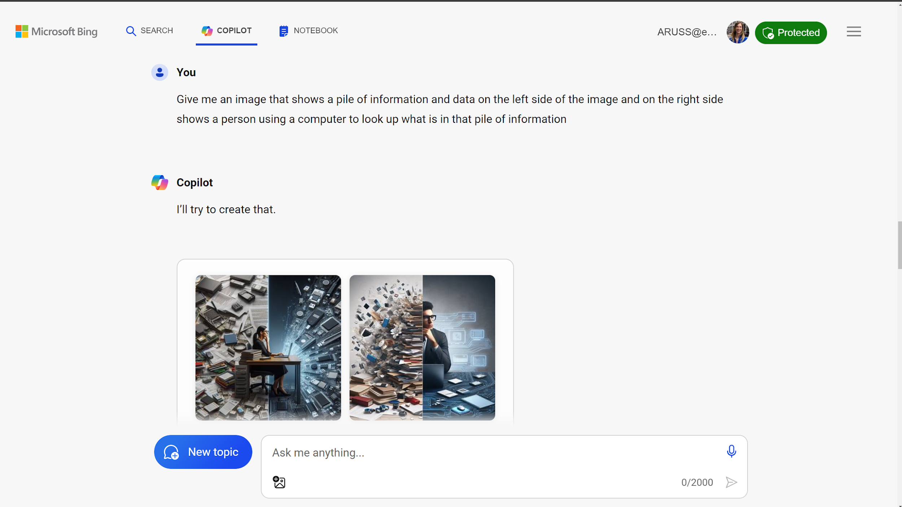
It all begins with a “prompt”
A typed input into an AI-chat system with the request for what you would like.
Prompt
Response

Slide 5
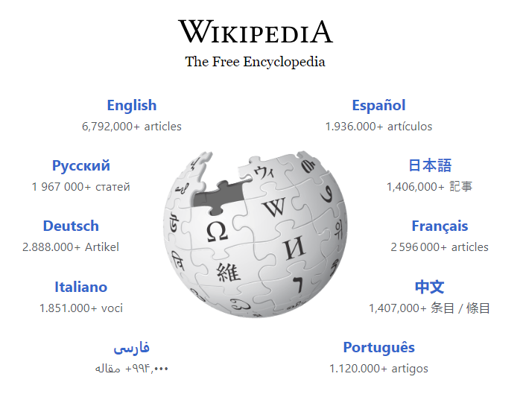
The basics “under the hood”:
Data of various kinds
Images
Text
3D Models
Videos
A prompt (text)
Convert to numbers
Machine learning models to relate data to text transposed to numbers
(math)
Place to interact with it (internet)
Predict response as numbers and convert to text (or images or models)
A response: text, or image, or video…

Slide 6
Some general “rules” to keep in mind
They are out of date on their information, unless “helped” with other software
Prompts are used to help retrain the models – so be careful with entering sensitive data!
The quality and bias of the response is statistically based on the quality and bias of the data in the training.
You will never get the same exact answer twice, even with the same prompt
You will always get an answer – even if it is wrong. We call this hallucination. Some systems have controls, others don’t.
Image credit: DALL-E

Slide 7
Case in point: Bias of training data
Prompt: Make me a picture of a football player

Slide 8
Case in point: Bias of training data
Prompt: Make me a picture of a Norwegian football player

Slide 9
Tip #1: Creative, Balanced or Precise?!
With many of the chat apps, you can choose the “personality” of the response. So which to pick?
There can also be speed differences between these. A good tip for increasing response speed is to ask in the prompt “to be brief” in the answer.
Other chatbots may have different personas on the speed versus quality spectrum.

Slide 10
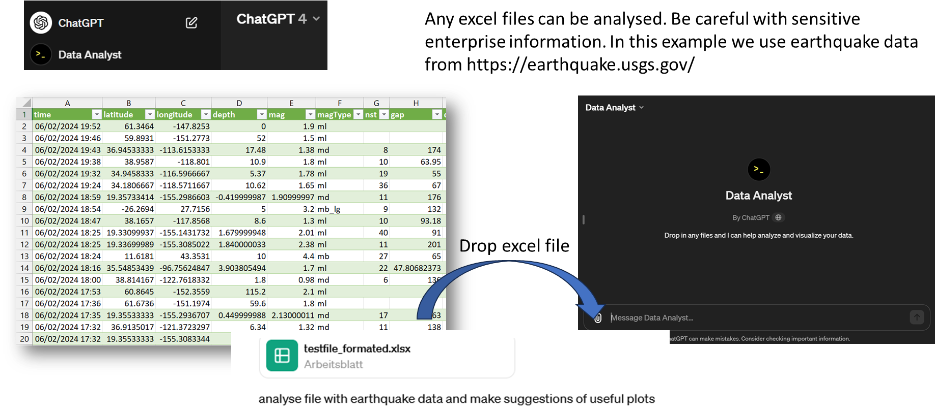
Tip #2: Quick analysis of excel files
prompt:

Slide 11
Tip #2: Quick analysis of excel files
ANALYSIS OF FILE CONTENT

Slide 12
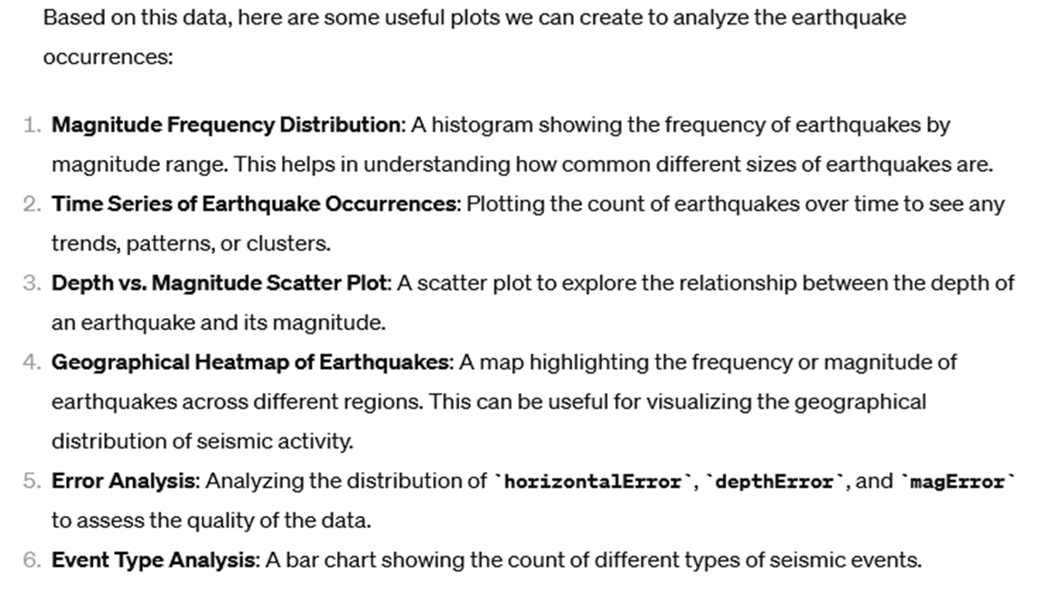
Tip #2: Quick analysis of excel files
SUGGESTION OF PLOTS

Slide 13
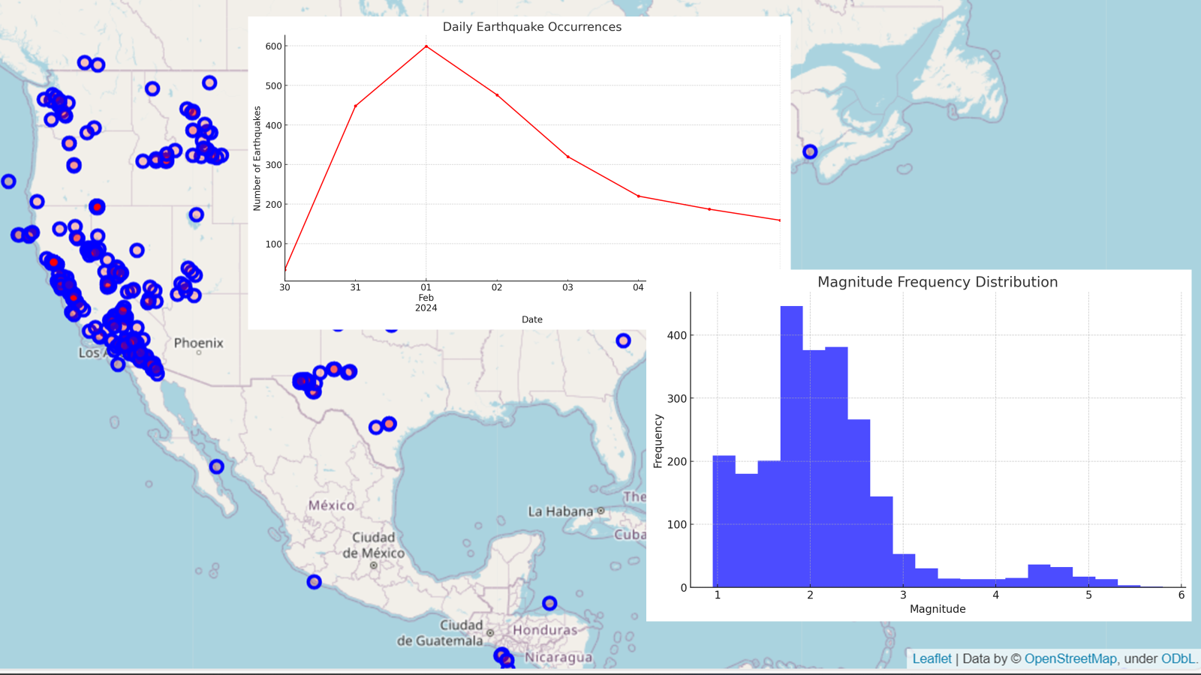
Tip #5: Quick analysis of excel files
Nicole
prompt: create …
Chatbot apps can help to quickly analyse and visualise excel files

Slide 14
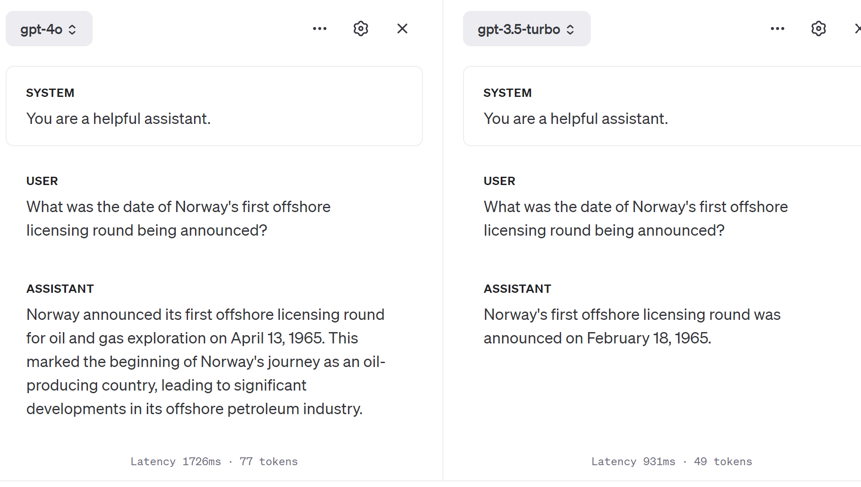
Tip #3: Need for speed or quality?
Latest Model
Old Model
Fast but wrong
Latency = Time to response

Slide 15
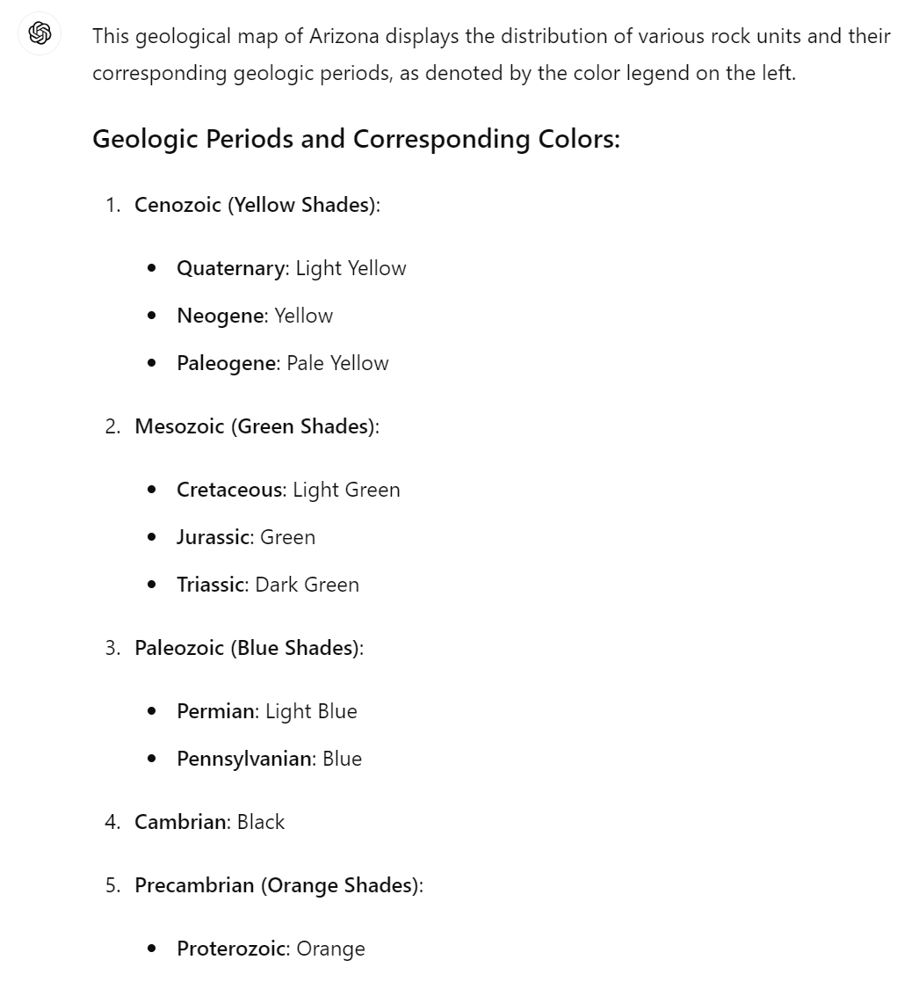
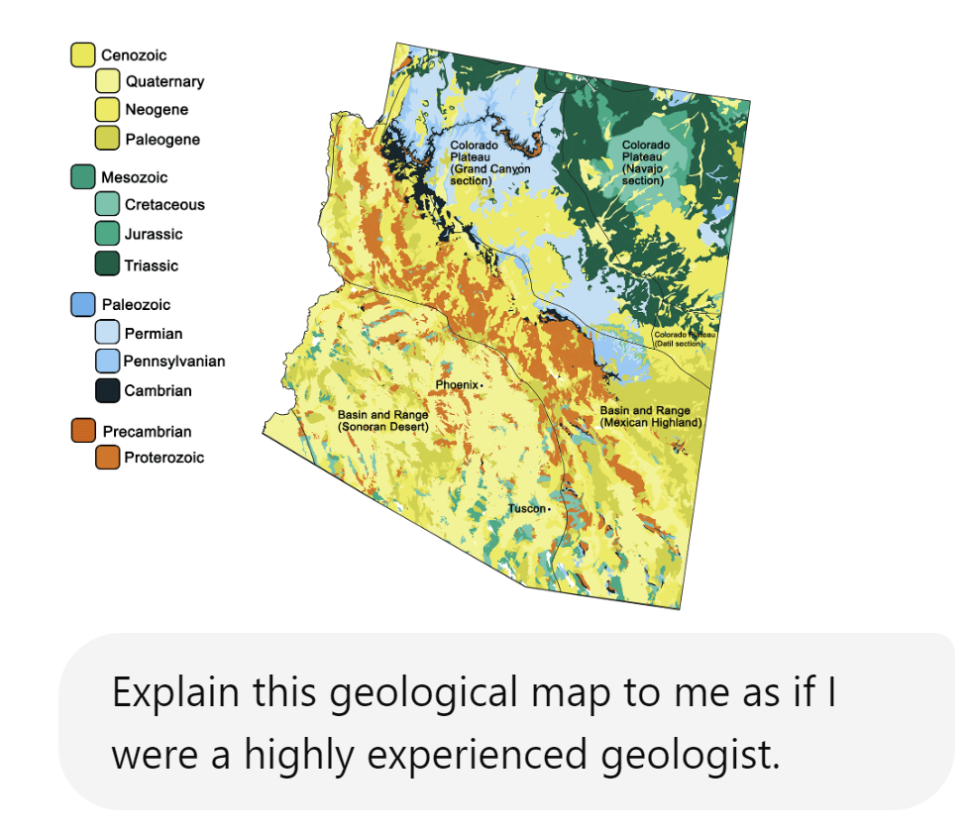
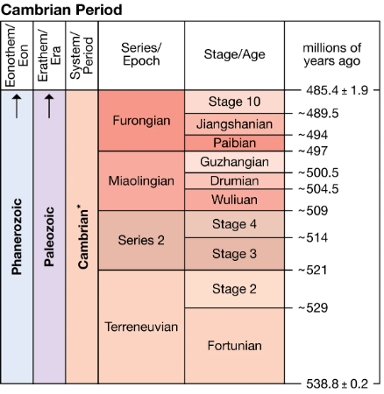
Tip #4: LLMs can “understand” images…
ChatGPT-4o
Works with ChatGPT
or Microsoft Bing Chat

Slide 16
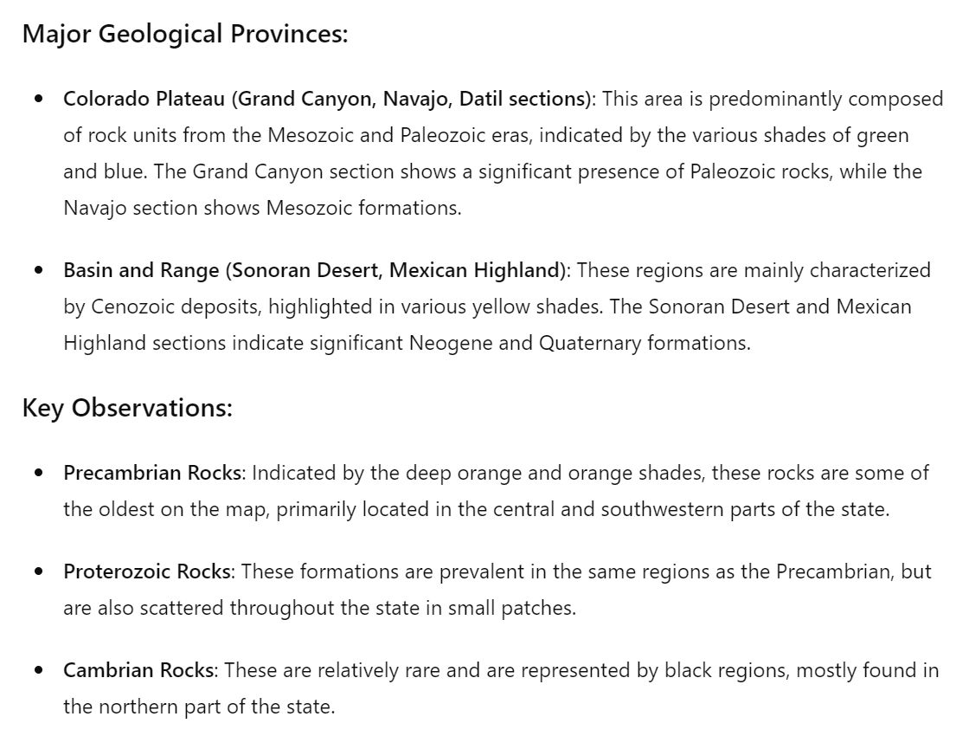
Tip #4: LLMs can “understand” images…
ChatGPT-4o
Works with ChatGPT
or Microsoft Bing Chat

Slide 17
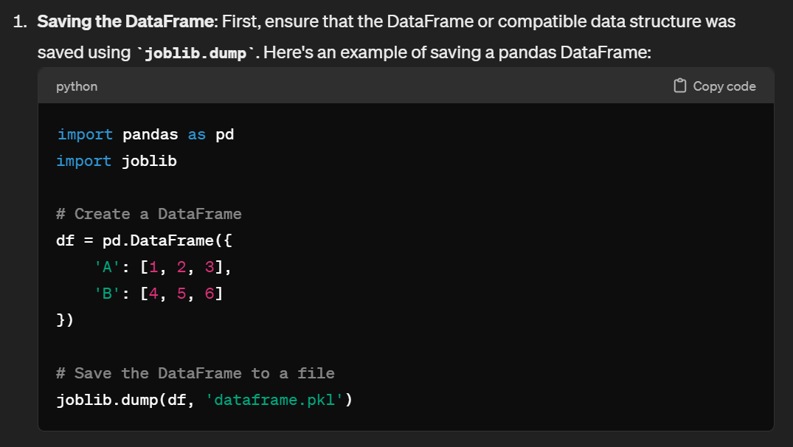
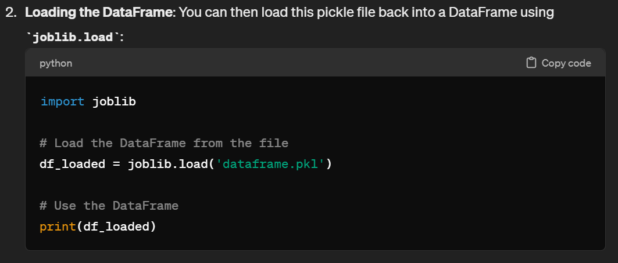
Tip #5: Sample code and explanations
Chatbots are very helpful for programmatic interactions with data, providing sample code to load them in a data frame for analysis and plotting.

Slide 18
Tip #5: Sample code and explanations
Language models are trained on a lot of code in popular programming languages and its respective documentation.
They can provide valuable information on which libraries to use, for example, for non-experts.
Double checking is always advised, however!

Slide 19
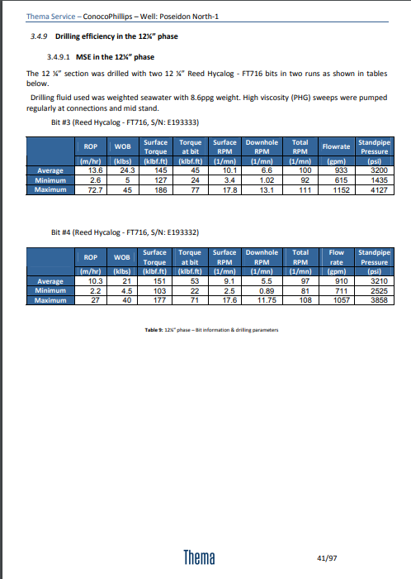
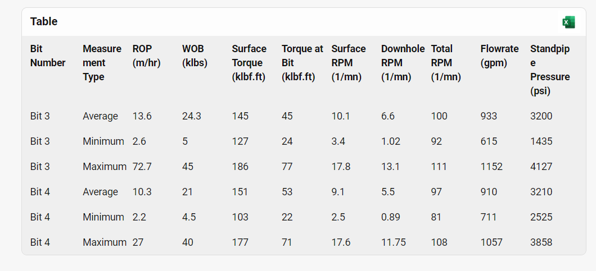
Tip #6: Organize report data into tables using Bing Copilot and go right to excel
Ashley
We have tables for different bits in a final well report. Want this in the same table, with the bit number added as an additional column
Final Well Report – Poseidon North – 1 (NOPIMS)

Slide 21
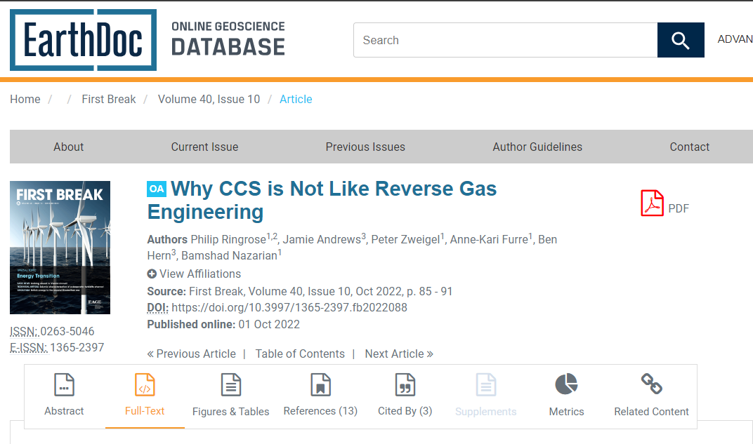
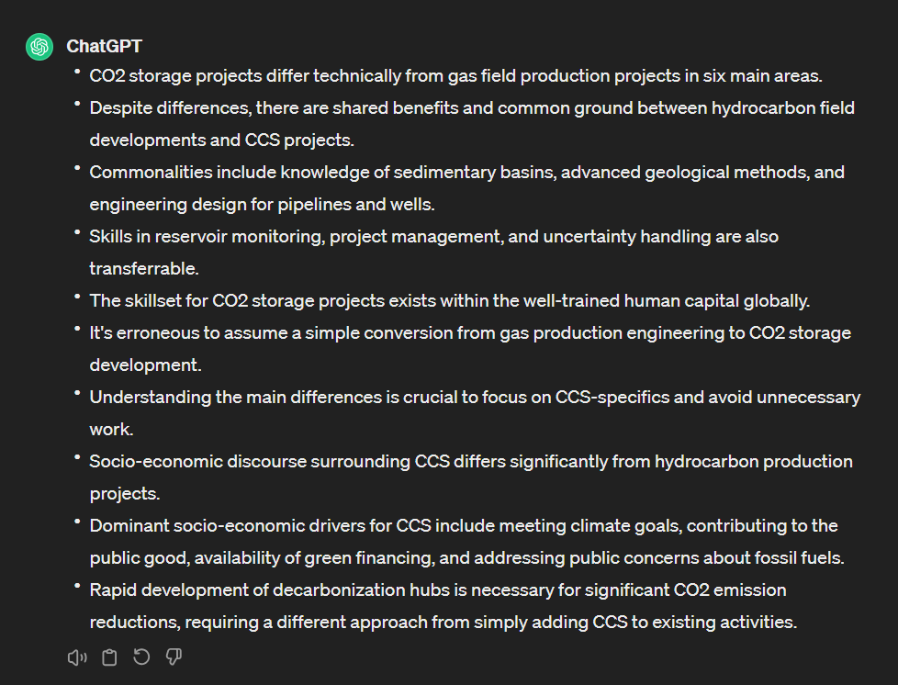
Tip #7: Quick Summaries in ChatGPT
Ashley
Need to get up to date on latest research fast? Ask GPT for a summary first to see if the paper is relevant for you to take a longer read!

Slide 23
Tip #8: Going from really bad data to a table

Slide 25
Given the rules: These AI chat systems have many possibilities in how they can be used – discovering new things continuously!
That is the human element – we use our creativity and reasoning to explore and critique what we can do with AI.
Image credit: DALL-E

Slide 26
Thank you for joining us!
Questions? Comments?

